Slide 1
Case Study for Cyclistic
By: Jeff Lin

Slide 2
The Problem:
How do annual members and casual riders use Cyclistic bikes differently?
Why would casual riders buy Cyclistic annual memberships?
How can Cyclistic use digital media to influence casual riders to become members?
This PowerPoint will cover the first problem

Slide 3

How do they differ? Why does it matter?

Slide 4
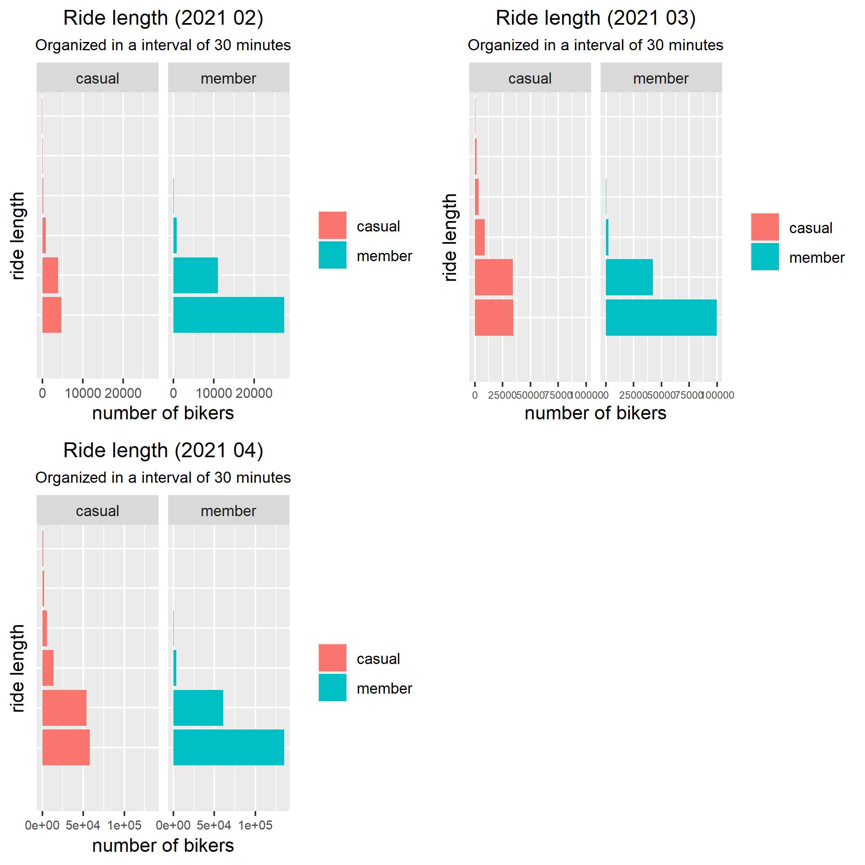
Ride length of Casual vs. members
The time interval is arranged by 30 minutes.
First bar less than 30 minutes, second around 30 minutes, third around an hour, etc.

Slide 5
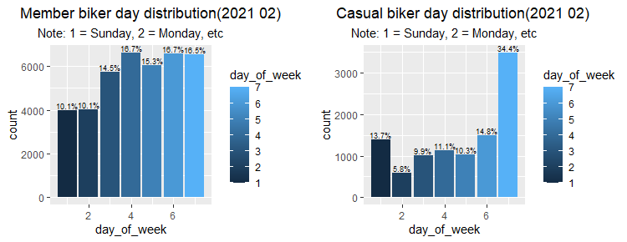
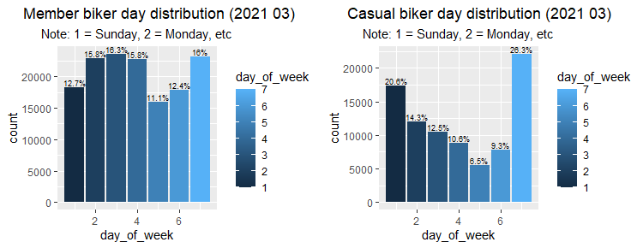
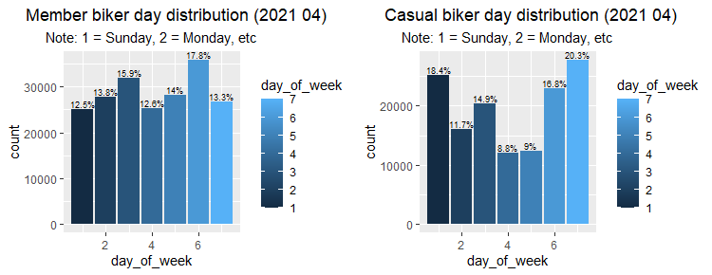
Day Distribution of a week

Slide 6
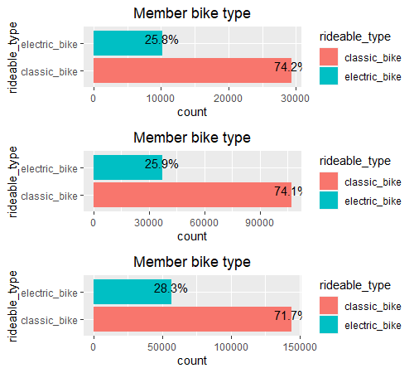
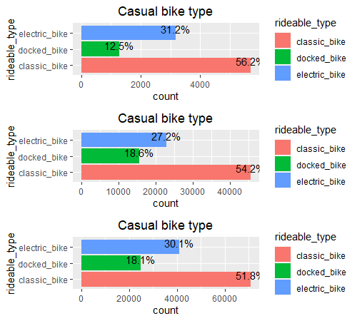
Bike type distribution

Slide 7
How do they differ? Why does it matter?

Slide 8

Why do these graphs matter?
By examining these graphs, there is some key difference between casual and member riders.
By utilizing the story these graphs are telling, there is a higher chance of converting casual riders to an annual member.

Slide 9
Solutions:
We can create a targeted ad or sale for casual riders who spend less than 30 minutes per ride.
Because most members spend < 30 minutes per ride, we can safely assume that casual riders who spend < 30 minutes per ride is a potential member.
By promoting extra benefits during the weekend to casual riders, there is a higher chance of converting them to members.
This is shown in the graph where majority of casual riders’ ride on the weekends.
Through the graph from bike type distribution, we can focus on the riders who ride docked bike as only casual riders use them. Converting those into members can marginally increase our profit.

Slide 10
Thank you for listening
All the data is collected from divvy-tripdata, an online public dataset
Further analysis will be needed regarding the last two problems.
Email: linjeff16@gmail.com

